Slide 1

Chinook Project
By Yasin Shaikh

Slide 2

Agenda
Problem Statement
Data Description
Objective Key Metrics and Visualizations
Subjective Question for Insights

Slide 3

PROJECT DESCRIPTION
To examine music record sales data in order to derive insights and formulate recommendations for the company's strategy within the physical music market.

Slide 4
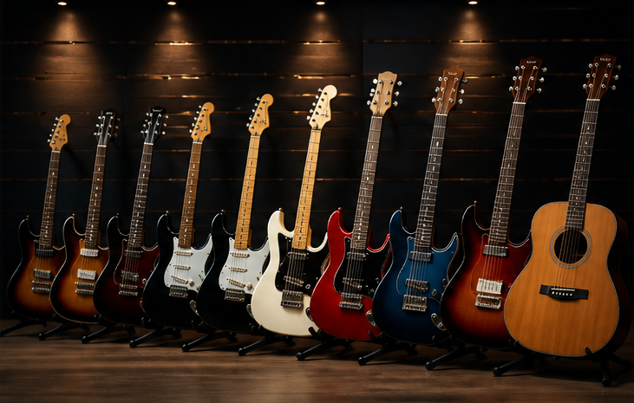


Chinook Music Store
Chinook Music emulates a digital music store, allowing users to effortlessly explore and buy tracks and albums.
It provides a varied music collection that encompasses numerous genres, assisting users in finding both popular and lesser-known tracks.
Through customized suggestions aligned with individual user preferences, Chinook improves music exploration and fosters customer loyalty.

Slide 5
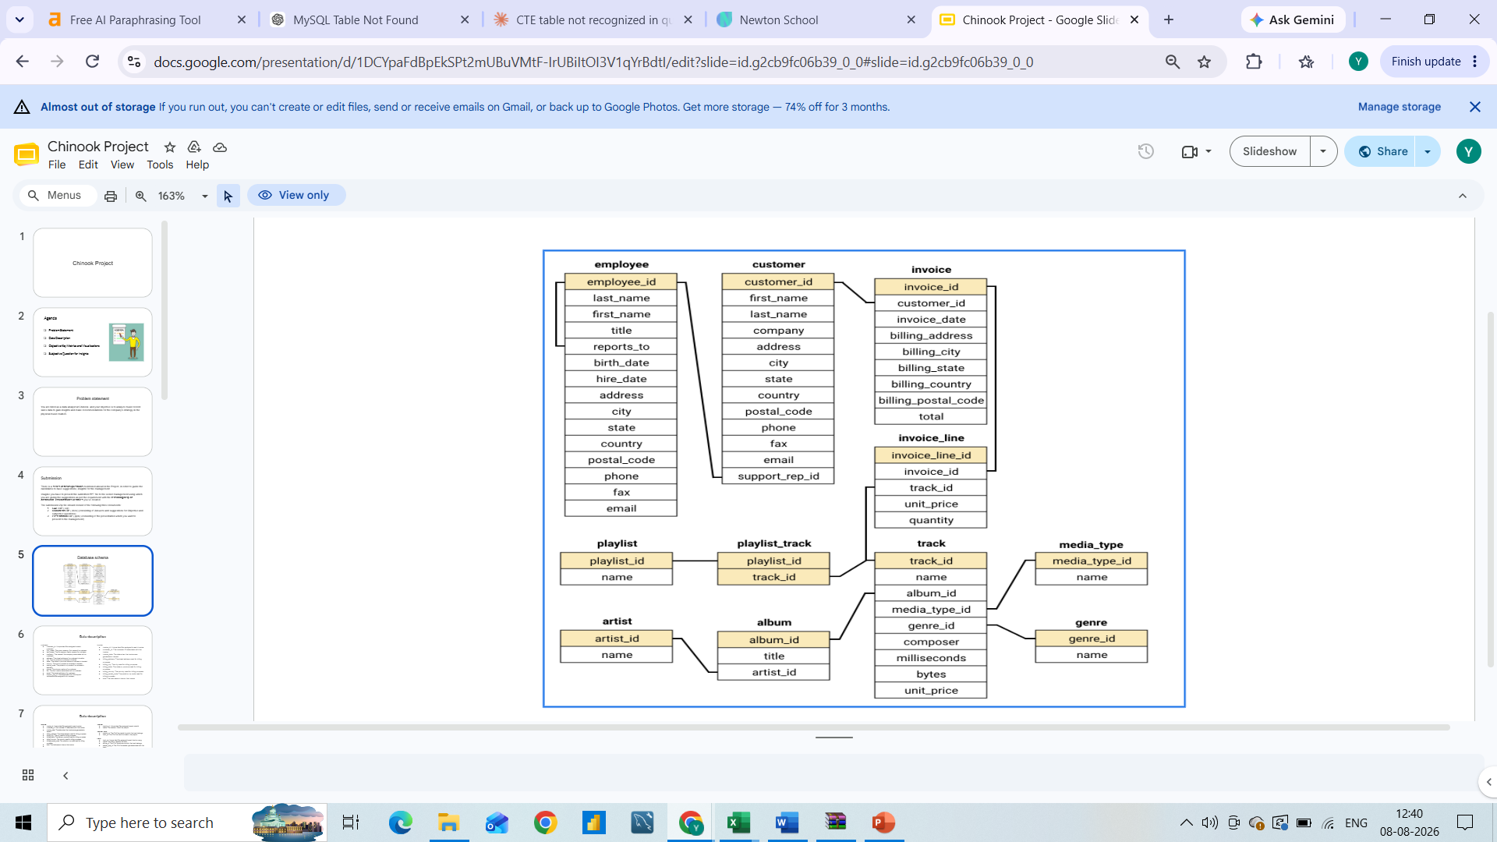
Database Schema

Slide 6
DATA OVERVIEW
customer:
customer_id: Unique identifier assigned to each customer.
first_name: The given name or first name of a customer.
last_name: The surname or family name of a customer.
company: The name of the company associated with a customer.
address: The street address of a customer's location.
city: The city where a customer is located.
state: The state or province where a customer is located.
country: The country where a customer is located.
postal_code: The postal or zip code of a customer's address.
phone: The phone number of a customer.
fax: The fax number associated with a customer.
email: The email address of a
customer.support_rep_id: The employee ID of the support representative assigned to a customer.
invoice:
invoice_id: Unique identifier assigned to each invoice.
customer_id: The customer ID associated with the invoice.
invoice_date: The date when the invoice was generated or issued.
billing_address: The street address used for billing purposes.
billing_city: The city used for billing purposes.
billing_state: The state or province used for billing purposes.
billing_country: The country used for billing purposes.
billing_postal_code: The postal or zip code used for billing purposes.
total: The total amount due on the invoice.

Slide 7
invoice:
invoice_id: Unique identifier assigned to each invoice.
customer_id: The customer ID associated with the invoice.
invoice_date: The date when the invoice was generated or issued.
billing_address: The street address used for billing purposes.
billing_city: The city used for billing purposes.
billing_state: The state or province used for billing purposes.
billing_country: The country used for billing purposes.
billing_postal_code: The postal or zip code used for billing purposes.
total: The total amount due on the invoice.
invoice_line:
invoice_line_id: Unique identifier assigned to each line item on an invoice.
invoice_id: The invoice ID to which the line item belongs.
track_id: The ID of the track or product included in the line item.
unit_price: The price per unit for the line item.
quantity: The quantity of units for the line item
.
playlist:
playlist_id: Unique identifier assigned to each playlist.
name: The name or title of the playlist.
playlist_track:
playlist_id: The ID of the playlist to which the track belongs.
track_id: The ID of the track included in the playlist.

Slide 8
album:
album_id: Unique identifier assigned to each album.
title: The title or name of the album.
artist_id: The ID of the artist associated with the album.
artist:
artist_id: Unique identifier assigned to each artist.
name: The name of the artist.
media_type:
media_type_id: Unique identifier assigned to each media type.
name: The name or description of the media type (e.g., MPEG audio file, AAC audio file).
track:
track_id: Unique identifier assigned to each track or song.
name: The title or name of the track.
album_id: The ID of the album to which the track belongs.
media_type_id: The ID of the media type associated with the track.
genre_id: The ID of the genre associated with the track.
composer: The name of the composer or artist who composed the track.
milliseconds: The duration of the track in milliseconds.
bytes: The file size of the track in bytes.
unit_price: The price per unit for the track.
genre:
genre_id: Unique identifier assigned to each genre.
name: The name or description of the genre (e.g., rock, pop, classical).

Slide 9
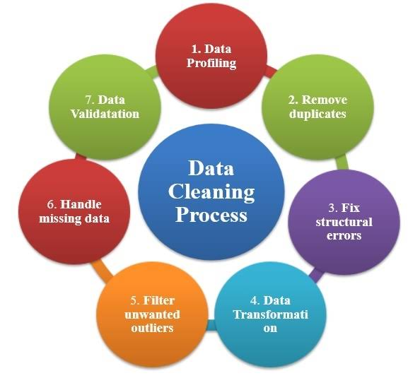
DATA CLEANING AND PROCESSING
Null check implementation: Executed specific SQL queries on key tables (employee, customer, and track) to detect absent data in critical fields.
Default value substitution: Utilized the COALESCE function to substitute null values with appropriate defaults such as "N/A" for company and "Unknown" for state, thereby enhancing data completeness in the customer table.
Ensuring data integrity: Conducted a thorough review of all tables for duplicate entries in primary key columns to maintain the reliability and uniqueness of the data.
Enhancing dataset quality: Tackled missing values while preserving the original records, thereby maintaining the dataset’s structure and enhancing its usability for subsequent analysis.

Slide 10
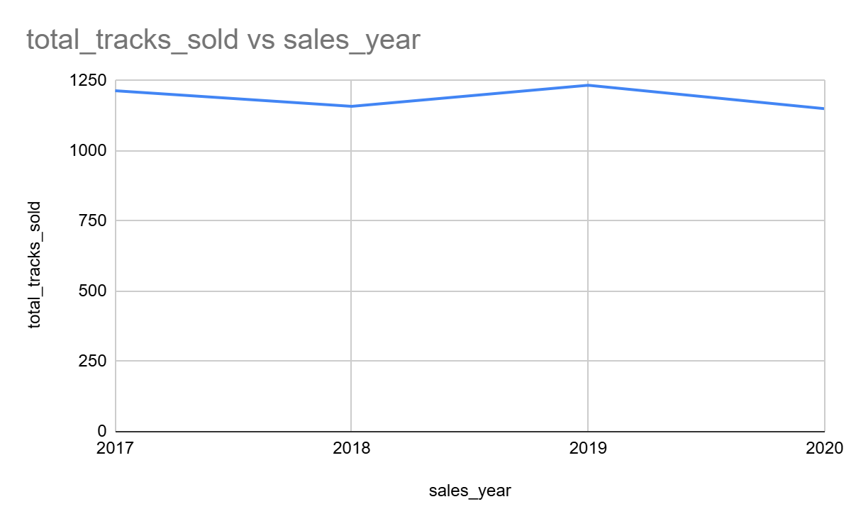
Yearly track sales analysis
sales_year | total_tracks_sold
2017 | 1214
2018 | 1159
2019 | 1234
2020 | 1150
Consistent Demand Over the Years
Sales of tracks exhibited a steady pattern from 2017 to 2020, varying between 1150 and 1234 units each year, which reflects a stable customer base and ongoing interest in music purchases.
2019 Sales Surge
The peak in track sales was recorded in 2019, reaching 1234 units, indicating a particularly successful year that may have been influenced by popular releases, effective marketing strategies, or heightened customer engagement.
Decline in Sales in 2020
In 2020, sales fell to 1150 units, marking the lowest figure in four years. This decline may be attributed to external factors (such as global events), a transition towards streaming services, or diminished marketing initiatives during that time.

Slide 11
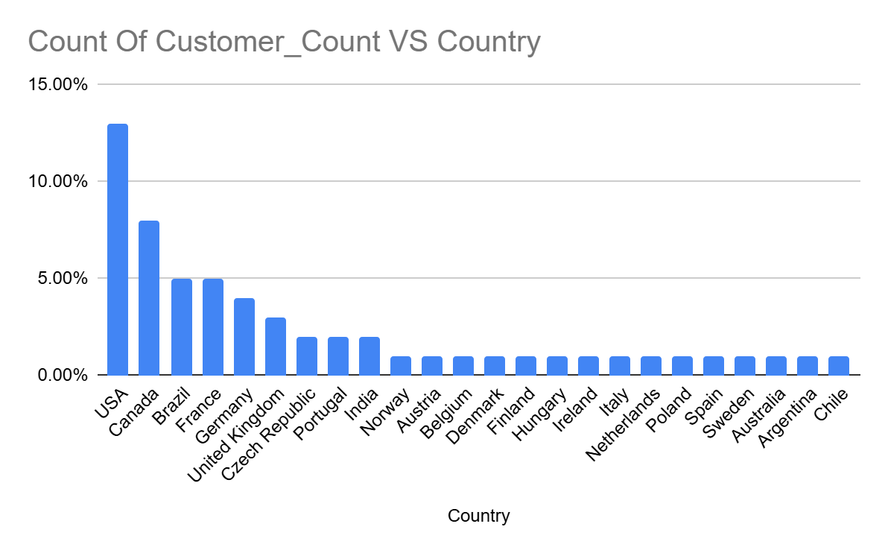
Percentage of customers across countries
The United States leads the customer base, accounting for more than 22% of all customers, with Canada following at 15%, and both France and Brazil at 7.5% each, highlighting a robust presence in North and South America.
Europe exhibits significant diversification, with numerous countries such as Germany, the UK, and Portugal contributing between 1.8% and 5.6%, reflecting a wide yet shallow European market.
The presence of many countries with low individual percentages points to opportunities for global expansion, but it also suggests that marketing strategies may need to be more localized to effectively engage dispersed audiences.

Slide 12
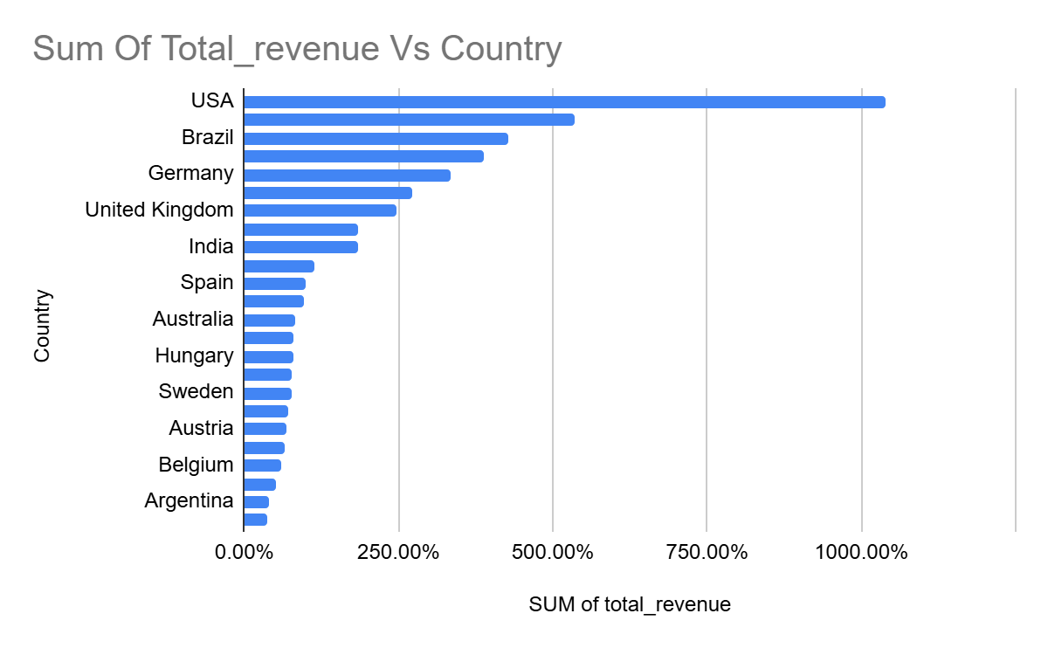
Percentage of total revenue across countries
The United States dominates in revenue generation, accounting for more than 22% of total sales, with Canada and Brazil following at 11% and 9%, respectively, demonstrating robust markets in both North and South America.
European nations such as France, Germany, and the Czech Republic together represent a considerable portion of sales, underscoring a varied yet important customer base within Europe.
The revenue contribution diminishes progressively after the top 10 countries, suggesting a long tail of nations that produce lower individual revenues but present opportunities for focused growth.

Slide 13
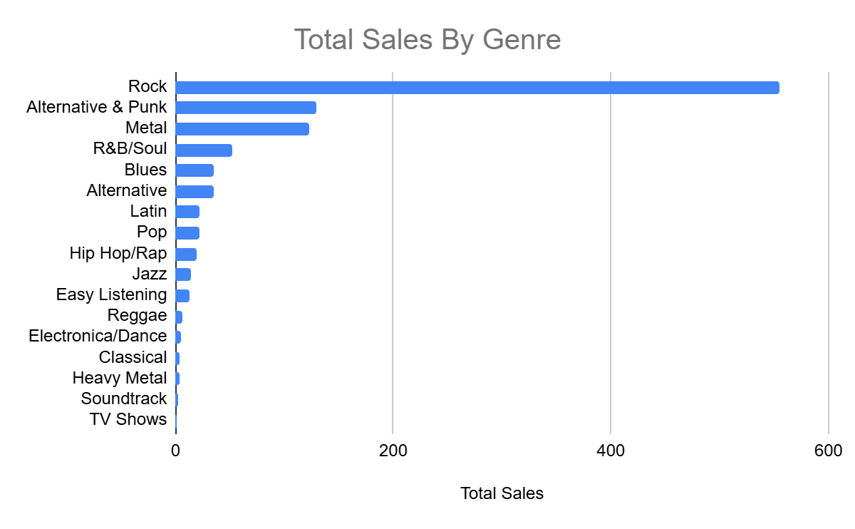
TOTAL SALES BY GENRE
Rock leads in sales, generating the highest revenue of $555.39—significantly surpassing all other music genres.
Alternative & Punk and Metal come next, yet their total sales remain below half of Rock's figure.
Genres such as TV Shows, Soundtrack, and Heavy Metal show minimal sales, suggesting either a lack of customer interest or restricted inventory in these areas.

Slide 14
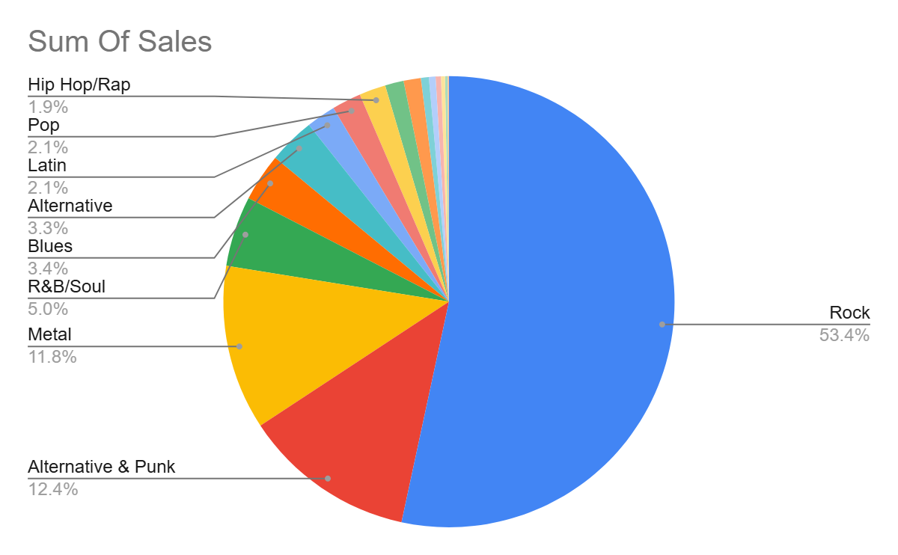
GENRE SALE PERCENTAGE
Rock leads the U.S. music market, accounting for more than 53% of overall music sales, a figure that far surpasses any other genre—demonstrating a robust consumer preference.
Alternative & Punk and Metal genres trail significantly, representing approximately 12% and 11.8% respectively, indicating that heavier and alternative music styles possess a strong yet niche following.
Genres such as Classical, Heavy Metal, and Soundtrack each contribute less than 1%, implying either a lack of demand or a restricted catalog in those categories.

Slide 15
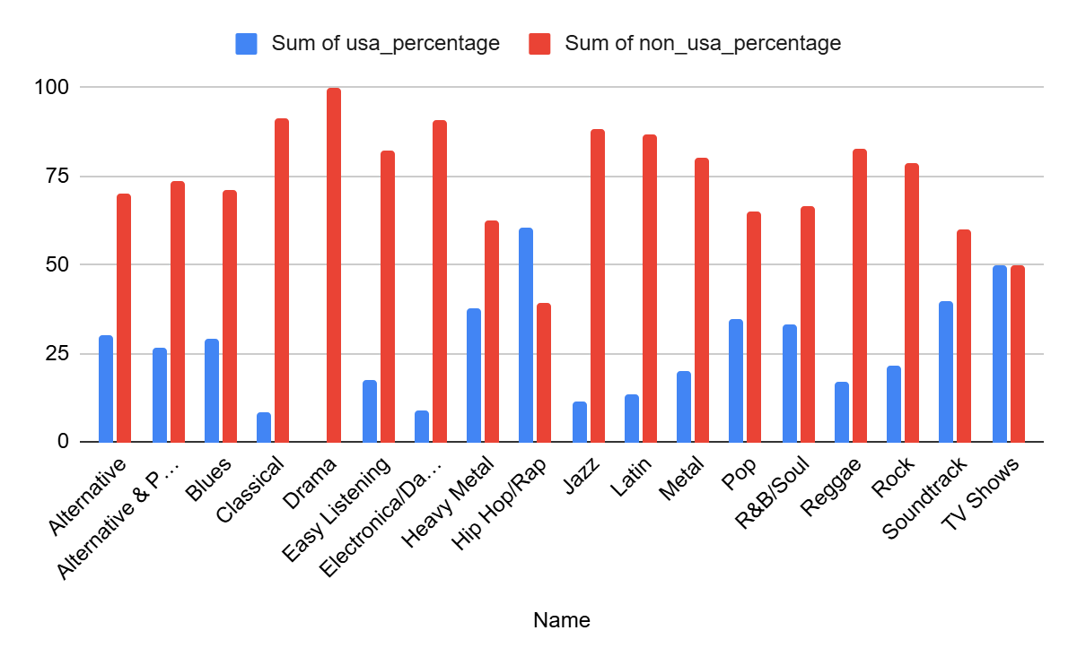
TOP SELLING GENRES PERCENTAGE IN USA AND OTHER COUNTRIES
Significant Presence of Non-USA Sales: Genres such as "Classical" (91.49%), "Electronica/Dance" (90.91%), and "Jazz" (88.43%) exhibit a considerably higher proportion of sales outside the USA. This indicates that these genres likely possess a more global fanbase and enjoy particular popularity in countries beyond the USA.
Genres with Equitable Sales: Certain genres, including "Soundtrack" (50%) and "TV Shows" (50%), demonstrate an equal distribution between USA and non-USA sales. This suggests that these genres may resonate equally with both domestic and international audiences.
USA-Centric Genres: Conversely, genres like "Hip Hop/Rap" (60.61%) and "Heavy Metal" (37.5%) show a notable share of sales originating from the USA, underscoring that these genres are especially favored among American listeners in comparison to other regions.

Slide 16
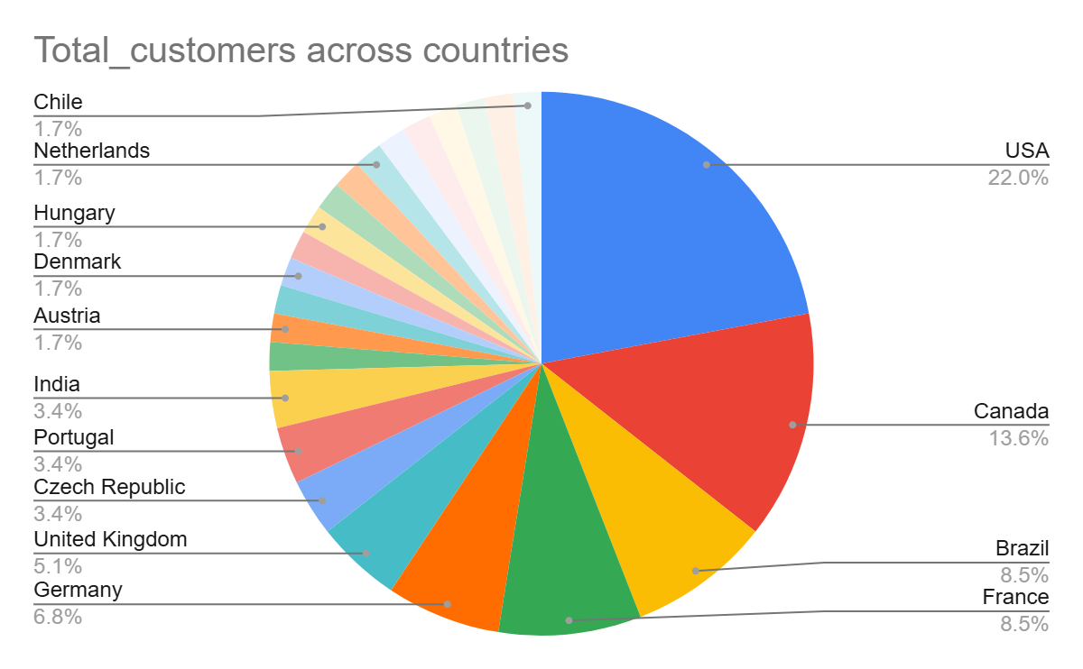
PERCENTAGE OF CUSTOMER ACROSS COUNTRIES
Key Markets: The United States, Canada, France, Brazil, and Germany together constitute 58.91% of the overall customer base. These areas are crucial markets, and concentrating marketing and sales initiatives in these regions could result in substantial returns.
Emerging Markets: Nations such as India, Portugal, and the Czech Republic, although smaller in terms of customer share (approximately 3.39% each), may exhibit growth potential. It could be beneficial to explore local strategies aimed at increasing market share in these developing markets.
Niche or Low-Share Markets: Numerous countries (including Sweden, Spain, Poland, among others) each account for 1.69% of the customer base. While these markets have lower individual customer shares, they collectively represent a varied customer segment that may provide valuable insights for regional diversification or customized offerings.

Slide 17
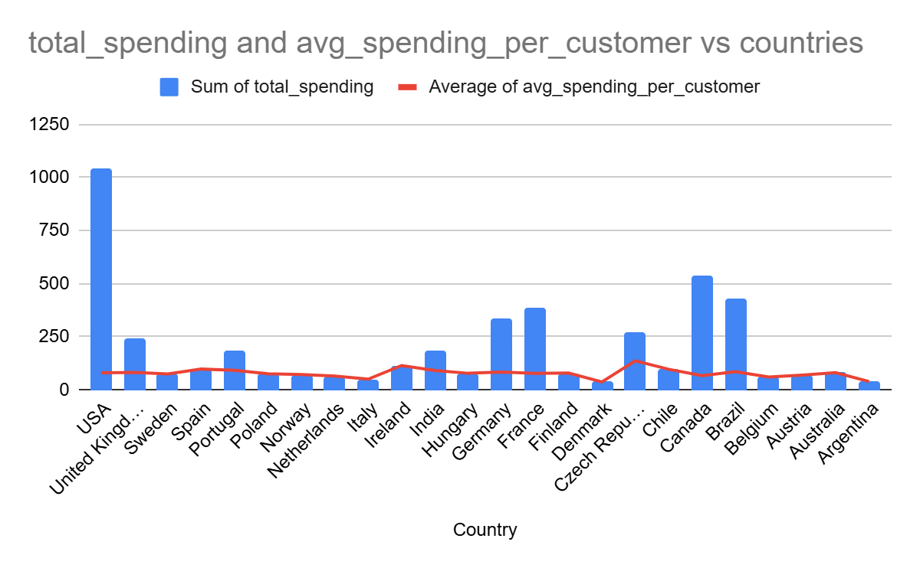
TOTAL SPENDING AND AVERAGE SPENDING VS COUNTRY
High-Value Markets: The United States, the United Kingdom, Germany, and France are distinguished by their substantial total expenditures, with the United States leading significantly at $1040.49. These markets not only boast large customer populations but also demonstrate high total spending, reflecting robust purchasing power and opportunities for future expansion.
Efficient Spend in Smaller Markets: Nations such as the Czech Republic, Ireland, and Portugal exhibit elevated average spending per customer (for instance, the Czech Republic at $136.62 and Ireland at $114.84), even though they have a smaller customer base. This indicates that, despite their size, customers in these markets are inclined to spend more on average, rendering them potentially profitable for focused marketing efforts.
Lower Spending in Some Countries: Countries like Denmark, Austria, and Argentina display lower total expenditures and average spending per customer. These markets may necessitate customized strategies to enhance customer engagement and increase spending, potentially through promotional activities or by broadening product ranges.

Slide 18
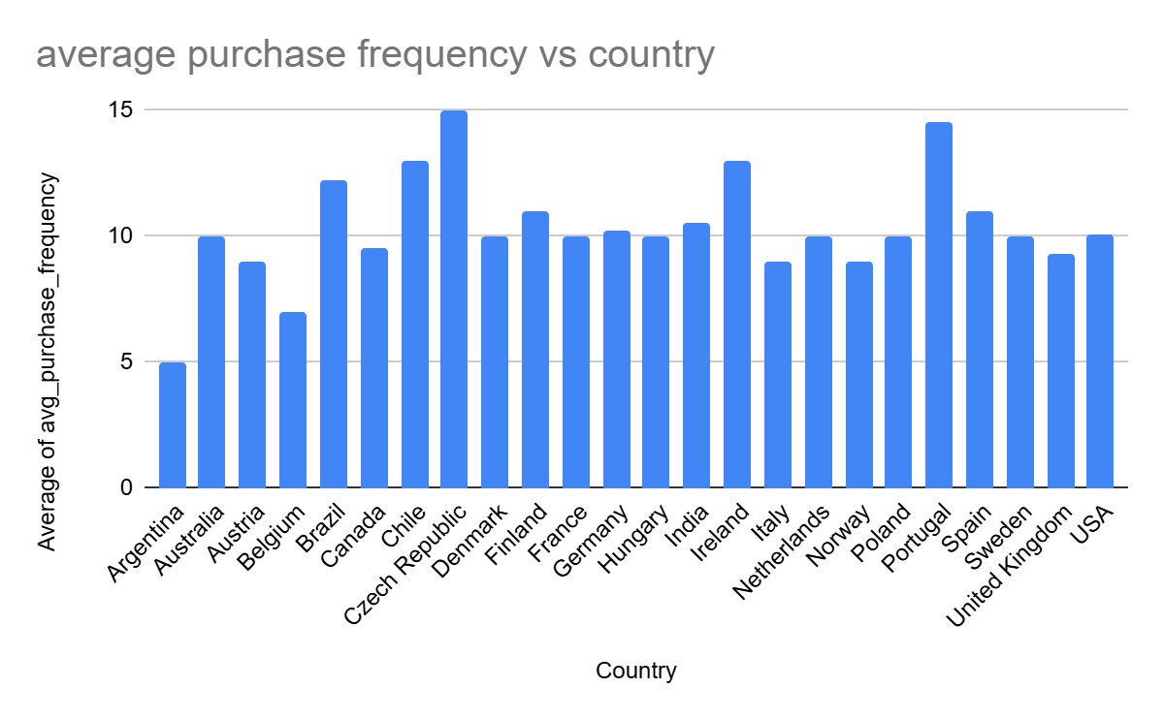
AVERAGE PURCHASE FREQUENCY VS COUNTRY
High-Value Markets: The United States, the United Kingdom, Germany, and France are distinguished by their substantial total expenditures, with the United States leading significantly at $1040.49. These markets not only boast large customer populations but also demonstrate high total spending, reflecting robust purchasing power and opportunities for future expansion.
Efficient Spend in Smaller Markets: Nations such as the Czech Republic, Ireland, and Portugal exhibit elevated average spending per customer (for instance, the Czech Republic at $136.62 and Ireland at $114.84), even though they have a smaller customer base. This indicates that, despite their size, customers in these markets are inclined to spend more on average, rendering them potentially profitable for focused marketing efforts.
Lower Spending in Some Countries: Countries like Denmark, Austria, and Argentina display lower total expenditures and average spending per customer. These markets may necessitate customized strategies to enhance customer engagement and increase spending, potentially through promotional activities or by broadening product ranges.

Slide 19
INSIGHTS ON INCREASING SALES
Sales reached their highest point in 2019 with 1,234 tracks sold, reflecting the effectiveness of marketing campaigns. Similar strategies can be applied to enhance future sales.
The rock genre accounts for 53% of total sales. It is advisable to focus on promoting rock albums and artists to maximize profitability.
Jimi Hendrix stands out with 2,624 sales. Re-releasing his work or offering exclusive content could enhance audience engagement.
The USA, Canada, and Brazil are identified as the leading markets. Implementing localized promotional strategies can further boost sales in these regions.
MPEG files are the most popular format, achieving 42,934 sales. Emphasis should be placed on this format while investigating the reasons behind the underperformance of video and protected formats.
There are potential opportunities in underperforming European and Asian markets that can be explored through targeted marketing campaigns.
Analyzing monthly and seasonal sales trends is essential to schedule promotions during peak purchasing periods.
Experimenting with bundle pricing and discount offers during slower sales periods may help increase overall sales volume.
Customer segmentation based on purchasing behavior, such as genre preferences or artist loyalty, should be utilized to customize marketing efforts.
Release timing and pricing should be informed by historical sales data to enhance the effectiveness of product launches.

Slide 20
CONCLUSION
In summary, the analysis of music sales data highlights significant opportunities for growth by concentrating on specific genres, promoting artists, and implementing market-specific strategies. Rock and MPEG formats demonstrate the highest demand, with 2019 serving as a pivotal year for successful campaigns. By focusing targeted efforts in high-performing areas such as the USA and emerging markets like Europe, reach can be significantly improved. Utilizing data-driven insights and seasonal trends will aid in refining future sales strategies.

Slide 21


